Slide 1
Inline Assembly 101
Ju Chen (TA CIS661/CSE655)

Slide 2

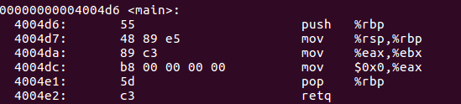
The first example - src/dst order, machine code, instruction-length
Machine
Code
Instruction
Mnemonic

Slide 3

Issuing Arbitrary Instruction Using .byte

Slide 4

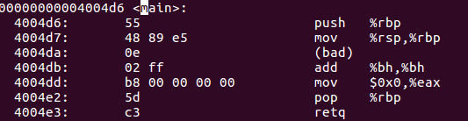

Issuing an unrecognized instruction

Slide 5

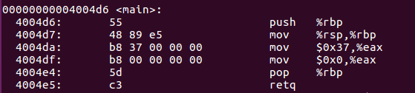
Dealing with Constant

Slide 6
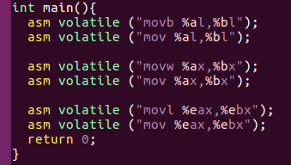
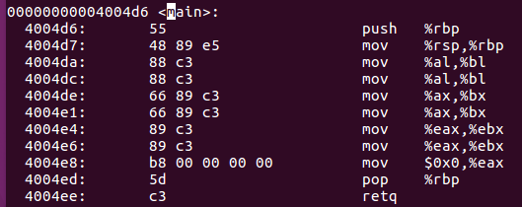
Size of operand

Slide 7
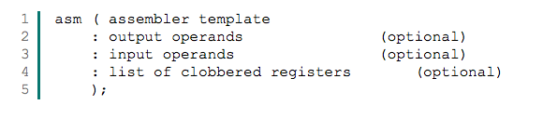
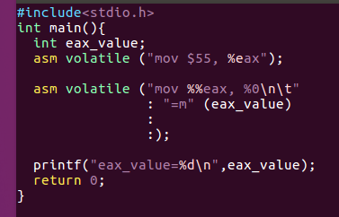
Interact with C - general format

Slide 8
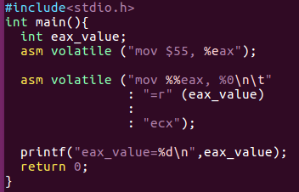


Operand constraint

Slide 9
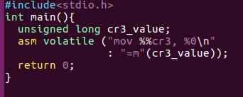
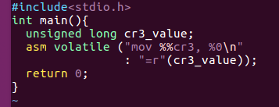

Use register constraint only when necessary!

Slide 10
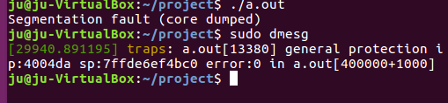
Unauthorized Instruction
Only allowed in ring-0 !

Slide 11
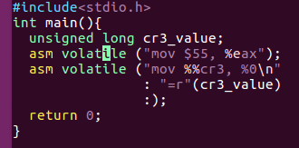
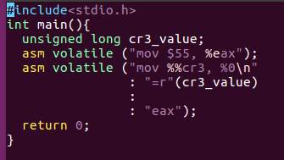


Using clobbered register list - a hint to compiler

Slide 12
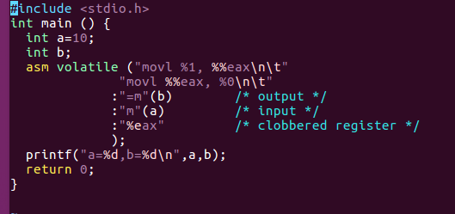
Putting it all together

Slide 13
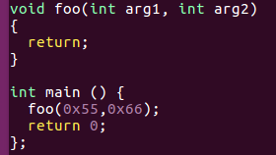
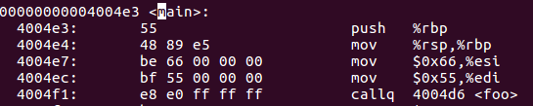

How arguments are passing? - calling convention

Slide 14
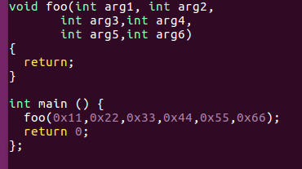
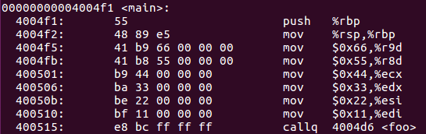
How arguments are passing? <=6 arguments
arg# | 1 | 2 | 3 | 4 | 5 | 6
reg | edi | esi | edx | ecx | r8 | r9

Slide 15
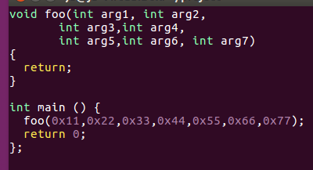
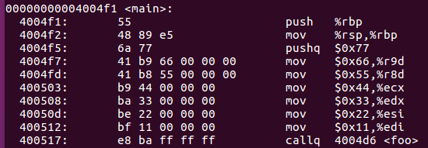
How arguments are passing? >6 arguments
For first 6, use registers, for the rest, use stack !

Slide 16
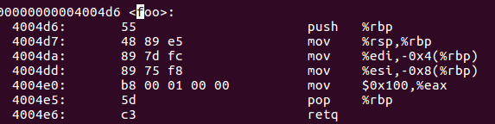
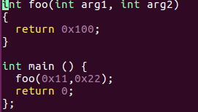
How about RETURN value - %eax

Slide 17
Warning - Calling convention is CPU-specific, OS-specific, Compiler-specific
X86
Microsoft
VC++
Unix/Linux
GCC, LLVM..
...
ARM
…
PowerPC
MIPS
...
What I’ve just shown is specific for x86-64 with GCC !

Slide 18
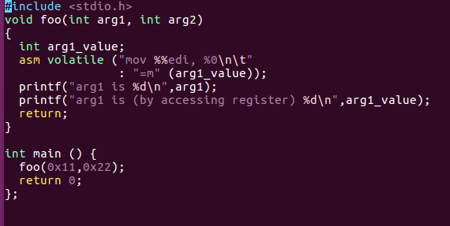

Taking advantage of this knowledge

Slide 19
Thank you!

